Slide 1
Migrate To Flow

Slide 2
AGENDA
Retirement Plan For Workflow Rule & Process Builder
Why Do We Need Flow?
Approaches for the Migration Process
Migrate To Flows
Manual Conversion Methods
Process Builder Migration

Slide 3
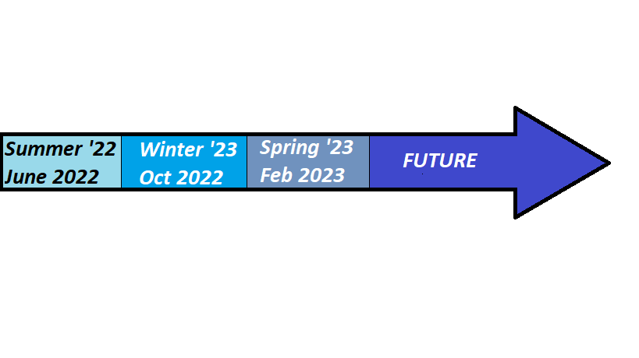
Retirement Timeline
Migrate To Flow Tool
Migrate to Flow Tool
Supports Process Builder
End of Support for WFR/PB
Estimated 2025
Support Workflow Rules
Turn off Create New
Workflow Rules
Turn off Create New
Process Builder

Slide 4
Why Do We Need Flow?
Performance tests conducted by Salesforce indicates that Before save flows can improve performance by 10-20 times over Workflows or Process Builders
Workflow rules and Process Builders use different runtime environment will never match flow’s faster performance and lower resource consumption
Salesforce efforts on Flow performance, debugging, management and deployment will not benefit either Workflow or Process Builder
Performance

Slide 5
Why Do We Need Flow?
Salesforce Flow includes a multitude of functionality that Workflow Rules and even Process Builder can’t do
Flow is the only declarative tool that offers the ability to handle multiple records at once in a collection( or List in Apex terminology)
Flow supports looping , which means that a Collection of variables or records can be iteratively processed one-by-one
Functionality

Slide 6
Why Do We Need Flow?
According to Salesforce, Flow is far better architectured to meet the increasing functionality and extensibility requirements of Salesforce users
Architecture

Slide 7
Why Do We Need Flow?
Salesforce has announced that the future for no-code automation is Flow-this means that development of new features will be largely around Flow
Any improvements Salesforce makes to Flow – such as debugging improvements, manageability improvements etc. - will not benefit Workflow Rules and Process Builders
Future Development

Slide 8
Approaches for the Migration Process
Approach#1
Manual
Approach#2
‘Migrate To Flow’ tool

Slide 9

Migrate
Workflow Rules
To Flows

Slide 10
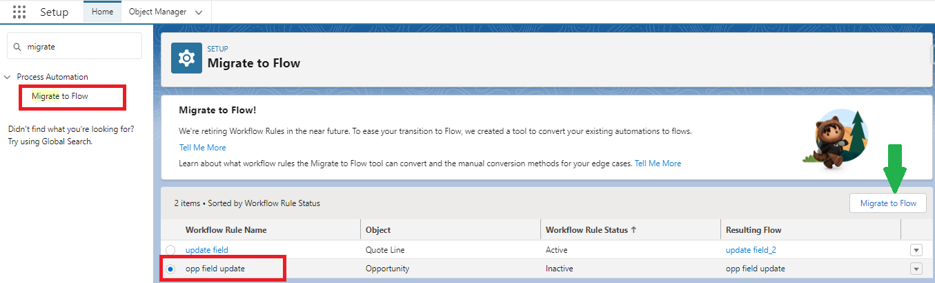
Find Migrate to Flow Tool

Slide 11
Migrate To Flow Tool Considerations
The Migrate to Flow tool supports workflow rules that contain these items.
Field-based criteria
Field updates
Email alerts
Outbound messages
Time-dependent workflow actions
Equal to null
Not equal to null
Rule criteria formula
Workflow rules that contain the following can't migrate with the Migrate to Flow tool.
Criteria with no defined workflow actions
Global variable fields
Fields on related records
Record types
The does not contain, includes, excludes, or within operators
The greater than, greater or equal, less than, less or equal operators on picklist fields
Task Creation action

Slide 12
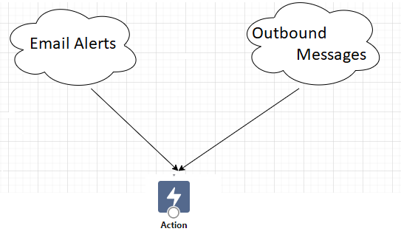
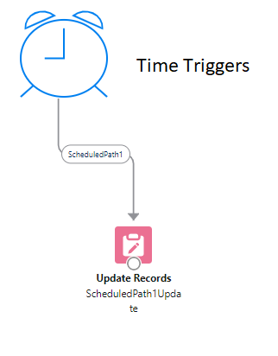
Equivalent Features in Flows and Workflow Rules

Slide 13
Equivalent Features in Flows and Workflow Rules
Workflow Rules | Flow
Rule Criteria | Start Element
Field Update | Update Record Element
Task Creation | Create Record Element

Slide 14
Operators
Workflow Rule | Flow
Does not contain | N/A
Equals | Equals
Excludes | N/A
Greater or equal | Greater than or equal(only number fields)
Greater than | Greater than(only number fields)
includes | N/A
Less or equal | Less than or equal(only number fields)
Less than | Less than
N/A | Ends with
N/A | Is Null

Slide 15
Manual Conversion Methods
Certain features are unsupported by the Migrate to Flow tool, but you can manually convert them.
To manually convert workflow rules with unsupported use cases in entry criteria, use the Decision element.
1. Create a Decision element inside the Flow as the first step.
2. Recreate the workflow rule steps with the condition builder.
Note: With this method, the flow will always run and check on the decision after entering. This method can impact performance or prevent time-based workflow triggers from migrating.

Slide 16
Manual Conversion Methods
To manually convert workflow rules that use the ‘does not contain’ operator, use custom condition logic.
For example, create a condition that uses the ‘Contains’ operator in the first condition, and in the condition logic, enter NOT 1.
To manually convert workflow rules that use tasks, use the Create Records option and create a record of the Task object.
Flows support workflow actions for Email Alerts and Outbound Messages. To add these workflow actions to a flow, use the ‘Action’ element.

Slide 17
Process Builder Migration
ConvertToFlow Tool
Manual
https://unofficialsf.com/the-new-converttoflow-app-migrates-most-of-your-process-builder-processes/

Slide 18
Thank You!

